Slide 1
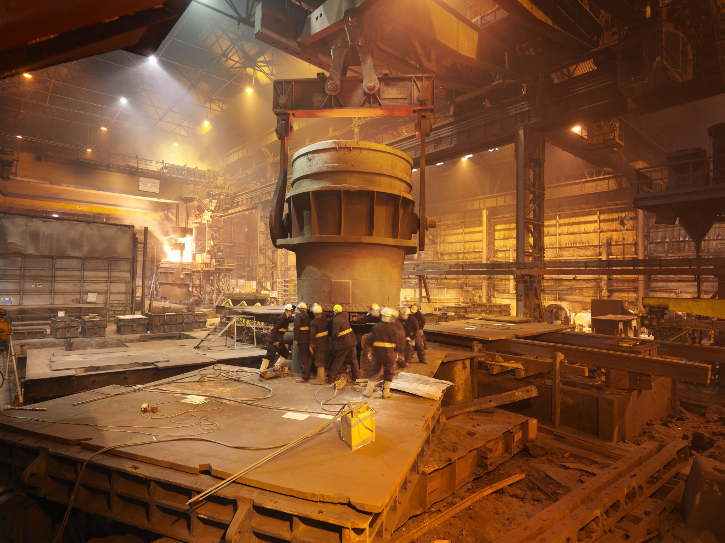
Introduction to Metal Casting
Is defined as something that has been cast in a mold, an object formed by the solidification of a fluid that has been poured or injected into a mold.

Slide 2
Categories of Metal casting process
Expendable mold processes- mold is sacrificed to remove part – Advantage: more complex shapes possible– Disadvantage: production rates often limited by time to make mold rather than casting itself
Permanent mold processes- mold is made of metal and can be used to make many castings – Advantage: higher production rates – Disadvantage: geometries limited by need to open mold ill be added here

Slide 3
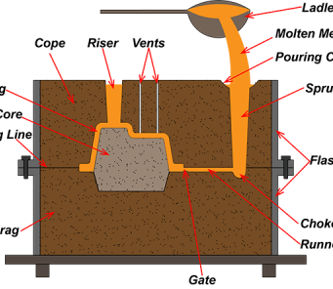
Sand Casting Overview
Sand casting, also known as sand molded casting, is a metal casting process characterized by using sand — known as casting sand — as the mold material.

Slide 4
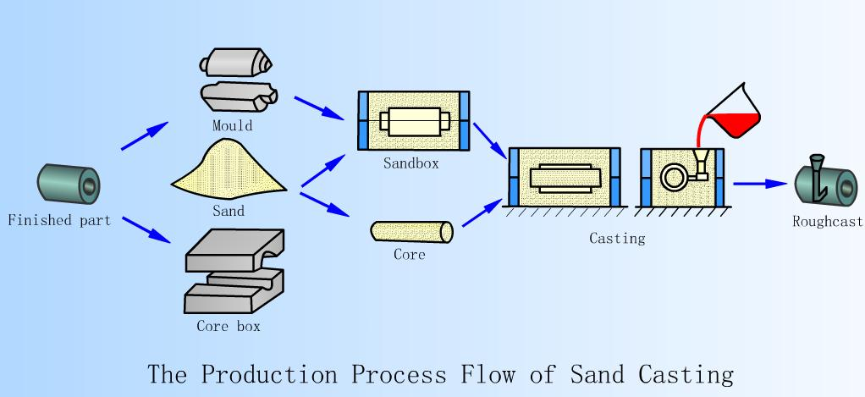
Steps in Sand Casting

Slide 5
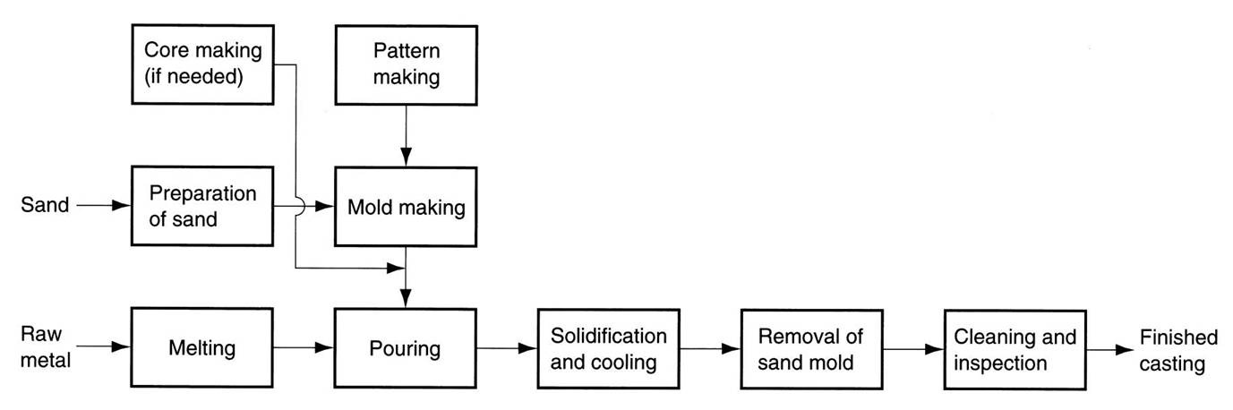
Production Sequence Steps in Sand Casting

Slide 6

Process details

Slide 7
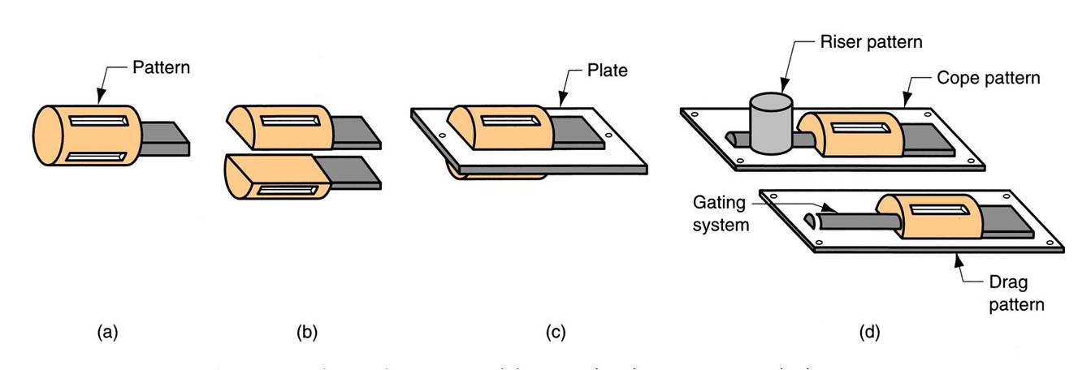
solid pattern split pattern match-plate pattern cope and drag

Slide 8
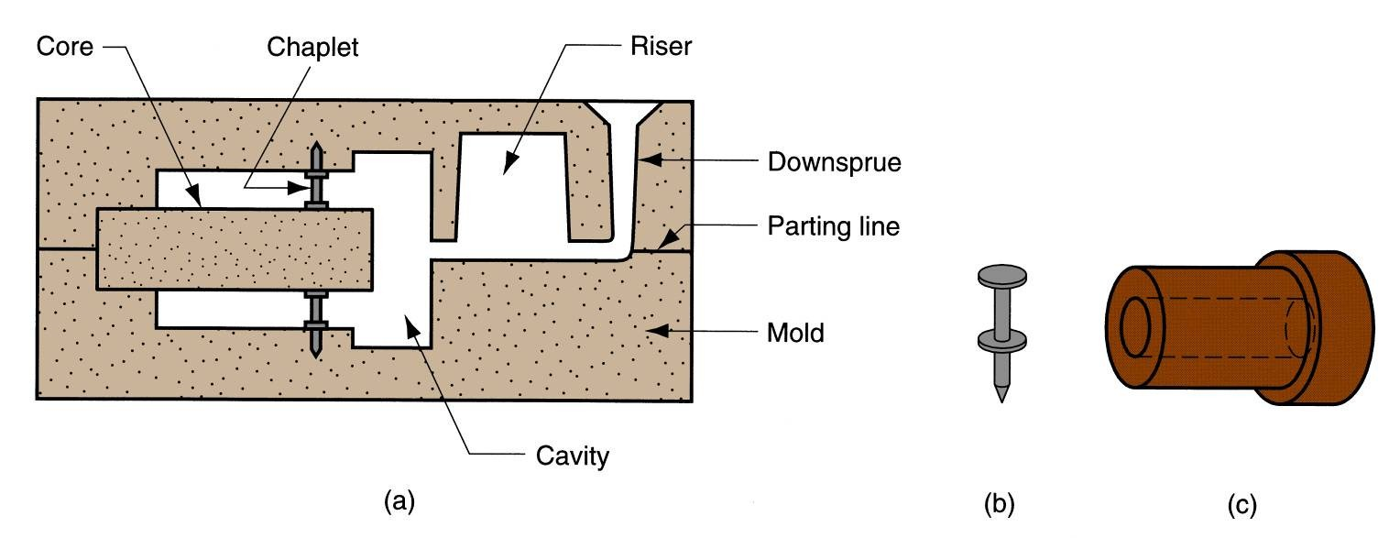
Useful Terms of Casting

Slide 9
Binders Used with Foundry Sands
Foundary sand - Silica or silica mixed with other minerals
Typical mix: 90% sand, 3% water, and 7% clay
Other bonding agents : Organic resins (e g , phenolic resins) Inorganic binders (e g , sodium silicate and phosphate) Additives (coal dust, corn flour, dextrin, seal coal, pitch, wood flour etc)

Slide 10
Types of Sand Mold
1.Green-sand molds- mixture of sand, clay, and water; “Green" means mold contains moisture at time of pouring .
2.Dry-sand mold- organic binders rather than clay and mold is baked to improve strength .
3.Skin-dried mold- drying mold cavity surface of a green-sand mold to a depth of 10 to 25 mm, using torches or heating lamps will be added here

Slide 11
Other Expendable Mold Casting Processes
Shell Molding Vacuum Molding Investment Casting Die Casting

Slide 12
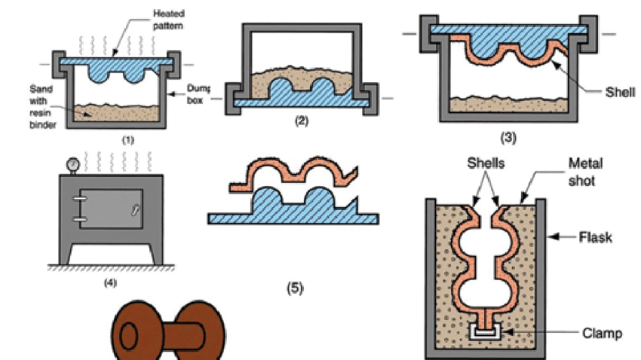
Shell Molding
Casting process in which the mold is a thin shell of sand held together by thermosetting resin binder

Slide 13
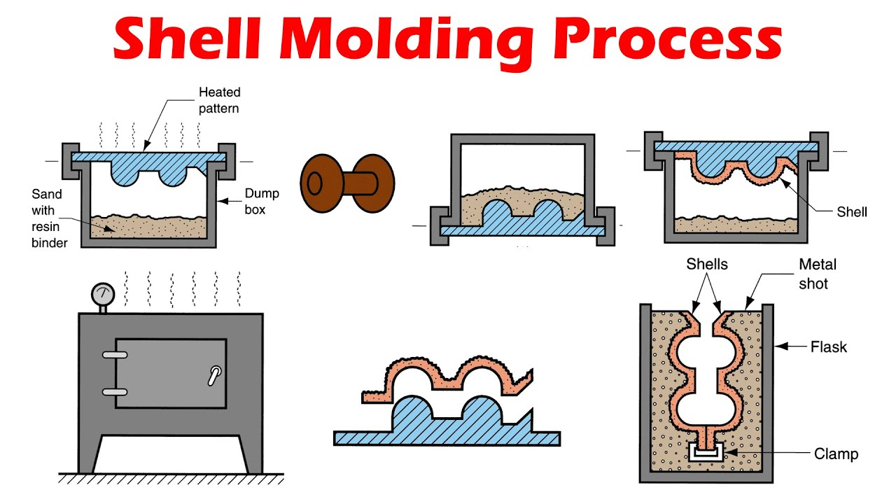

Slide 14
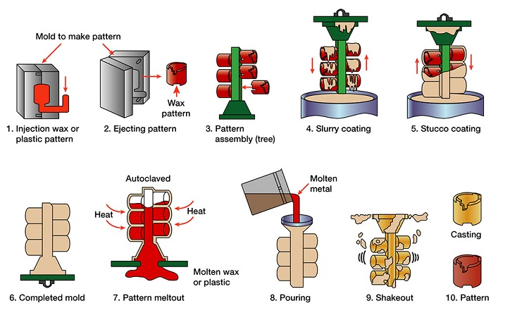
Investment Casting
"invest" - "to cover completely,"

Slide 15
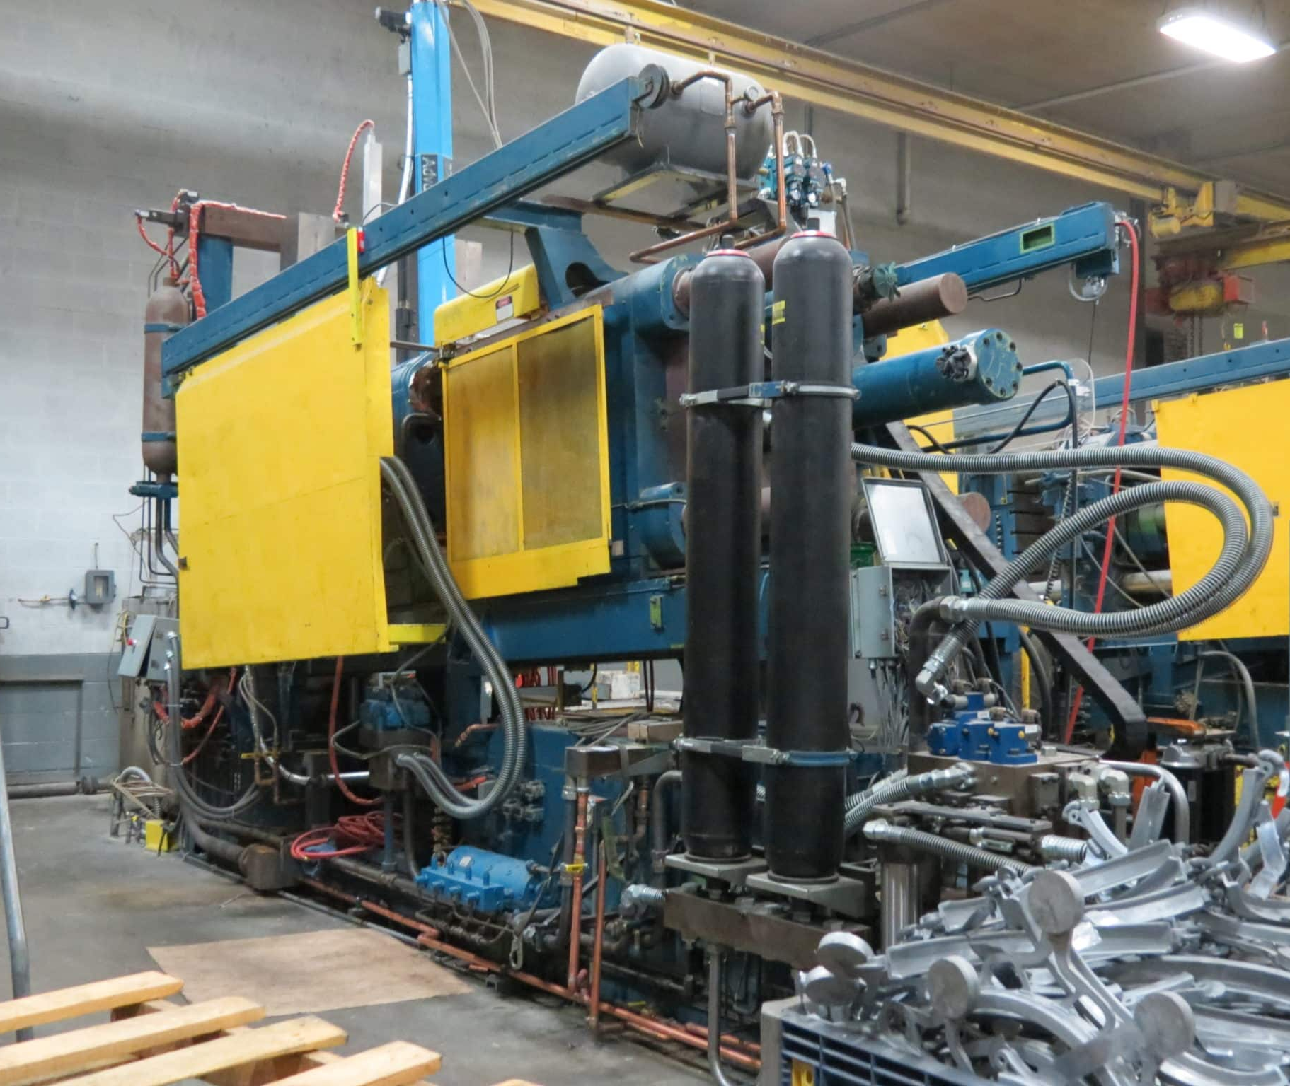
Die casting
A permanent mold casting process in which molten metal is injected into mold cavity under high pressure

Slide 16
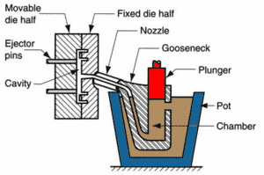
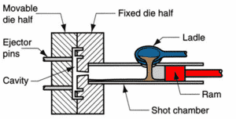
Die Casting
Hot die casting cold die casting

Slide 17
Centrifugal Casting process
A group of casting processes in which the mold is rotated at high speed so centrifugal force distributes molten metal to outer regions of die cavity
The group includes:
True centrifugal casting
Semi-centrifugal casting–
Centrifuge casting

Slide 18
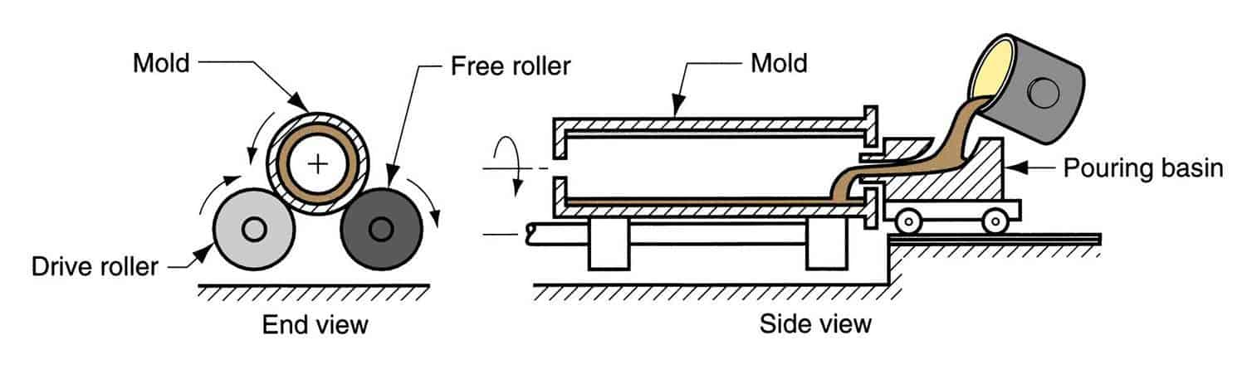
True centrifugal casting

Slide 19
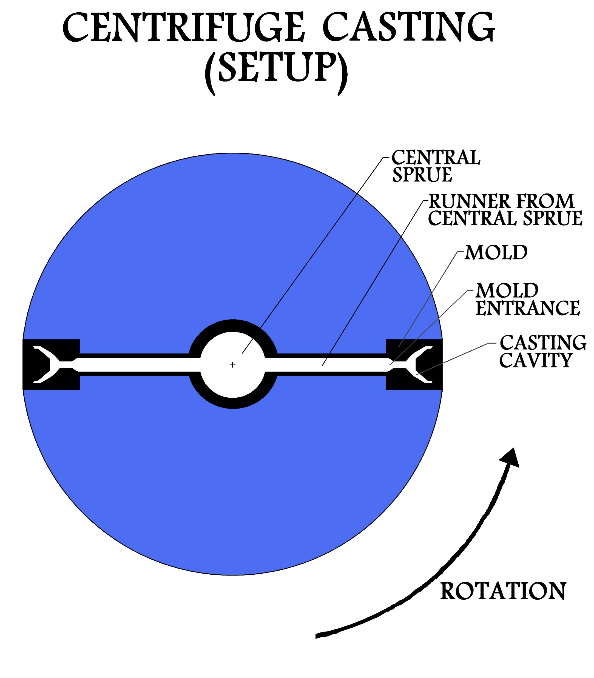
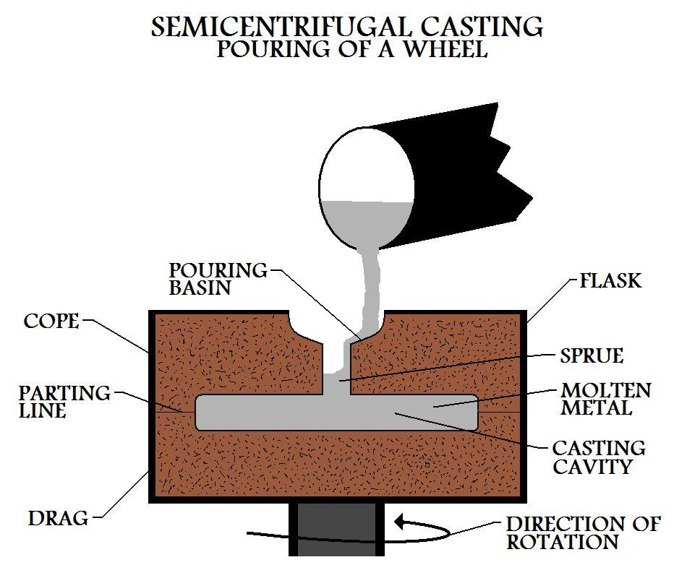
Types of centrifugal casting

Slide 20
CONCLUSION
Casting is a critical process in any production, setting the foundation for the entire project.
The right cast can bring characters to life, enhance storytelling, and captivate audiences.Effective casting requires careful consideration of actors' skills, chemistry, and suitability for their roles.
A successful cast can elevate a project, while poor casting choices may hinder its success.

Slide 21
References Used
https://plymouthfoundry.com/a-101-guide-to-sand-casting/ https://www.open.edu/openlearn/science-maths-technology/engineering-technology/manupedia/resin-shell-casting https://cwmdiecast.com/what-we-do/die-casting-process/what-is-high-pressure-die-casting/

